Slide 1
GOOGLE
TOOLS

Slide 2
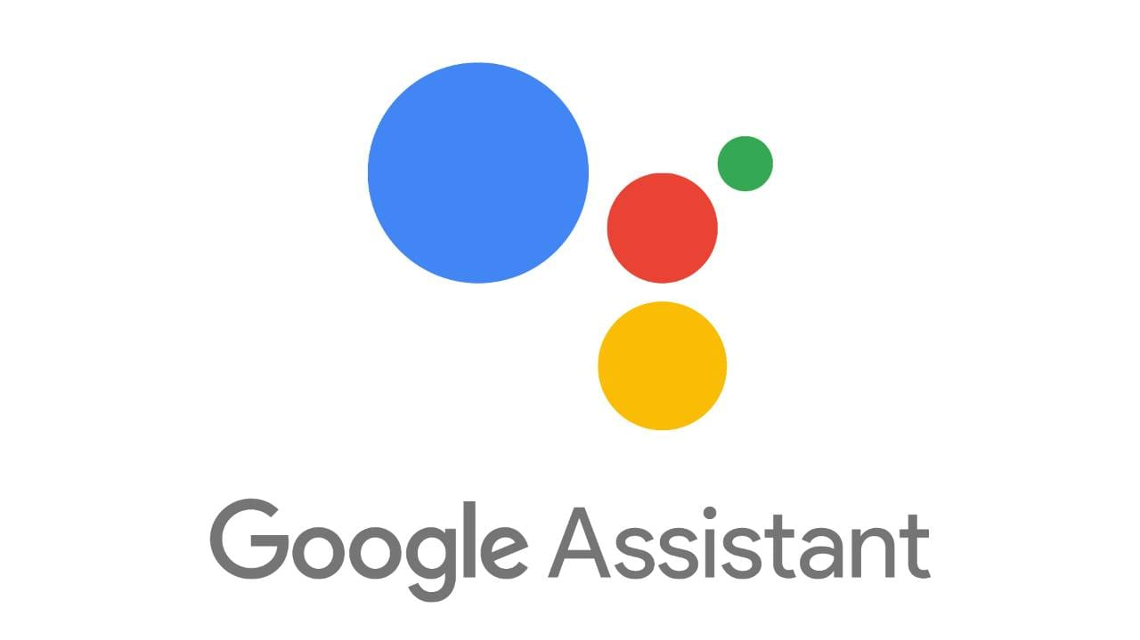
GOOGLE ASSISTANT
Google Assistant is a virtual assistant software application developed by Google that is primarily available on home automation and mobile devices. Based on artificial intelligence, Google Assistant can engage in two-way conversations, unlike the company's previous virtual assistant.

Slide 3
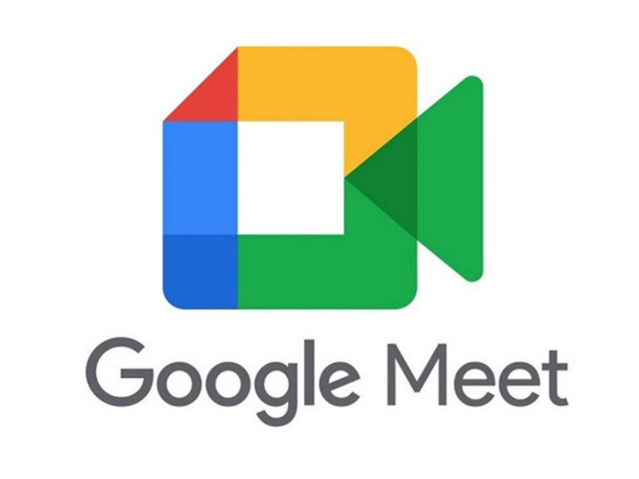
GOOGLE MEET
Google Meet is a video communication service developed by Google. It is one of two apps that constitute the replacement for Google Hangouts, the other being Google Chat.
Google Meet is available to Android and iOS devices, as well web application.[24] Compatibility with Android TV it was launched in 2022, replacing Google Duo app, with the possibility of making calls, but not supported currently to create or join meetings,[25] and offered compatibility in Samsung Smart TV in October 18, 2022,[26] but was discontinued on March 9, 2024.[27]

Slide 4
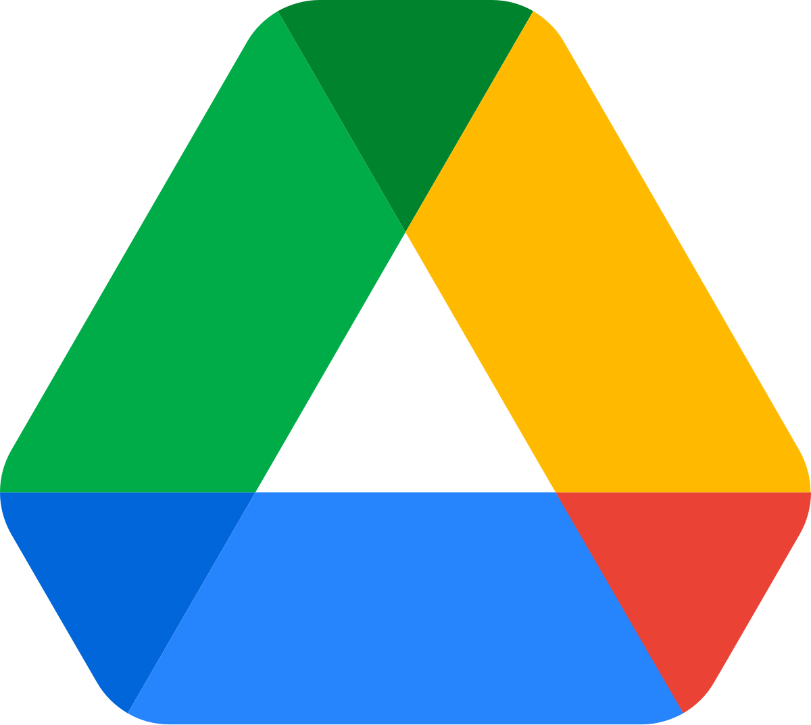
GOOGLE DRIVE
Google Drive is a file-hosting service and synchronization service developed by Google. Launched on April 24, 2012, Google Drive allows users to store files in the cloud, synchronize files across devices, and share files.
Google Drive offers users 15 GB of free storage, sharing it with Gmail and Google Photos. Through Google One, Google Drive also offers paid plans at tiers of 100 GB and 2 TB, along with a premium 2 TB plan that comes with Google's artificial intelligence. Files uploaded can be up to 750 GB in size. Users can change privacy settings for individual files and folders, including enabling sharing with other users or making content public. On the website, users can search for an image by describing its visuals, and use natural language to find specific files, such as "find my budget spreadsheet from last December".

Slide 5

GOOGLE GROUPS
Google Groups is a service from Google that provides discussion groups for people sharing common interests. Until February 2024, the Groups service also provided a gateway to Usenet newsgroups, both reading and posting to them,[1] via a shared user interface. In addition to accessing Google Groups, registered users can also set up mailing list archives for e-mail lists that are hosted elsewhere.[2]
Google Groups became operational in February 2001, following Google's acquisition of Deja's Usenet archive. Deja News had been operational since March 1995.
Google Groups allows any user to freely conduct and access threaded discussions, via either a web interface or e-mail. There are at least two kinds of discussion groups: forums specific to Google Groups (like mailing lists)[3] and Usenet groups, accessible by NNTP, for which Google Groups acts as gateway and unofficial archive. The Google Groups archive of Usenet newsgroup postings dates back to 1981.[4]
Google Groups no longer supports posting or viewing new Usenet content since February 22, 2024. Existing archives remain available.[5][6]

Slide 6

GOOGLE DRAWINGS
Google Drawings is a diagramming software included as part of the free, web-based Google Docs Editors suite offered by Google. The service also includes Google Docs, Google Sheets, Google Slides, Google Forms, Google Sites, and Google Keep. Google Drawings is available as a web application and as a desktop application on Google's ChromeOS. The app allows users to create and edit flowcharts, organisational charts, website wireframes, mind maps, concept maps, and other types of diagrams online while collaborating with other users in real-time.
It allows importing images from the computer or from the Web as well as inserting shapes, arrows, scribbles and text from predefined templates. Objects can be moved, resized and rotated. The software also allows for basic editing of images, including cropping, applying masks and adding borders.[1] Other features include laying out drawings precisely with alignment guides, snapping to grid, and auto-distribution. Unlike many of the other software in the Google Docs Editors suite, Google Drawings does not have its own dedicated home, as visiting the Google Drawings URL creates a new document.

Slide 7

GOOGLE KEEP
Google Keep (formerly Google Notes and appears in app launcher as Keep Notes) is a note-taking service included as part of the free, web-based Google Docs Editors suite offered by Google. The service also includes: Google Docs, Google Sheets, Google Slides, Google Drawings, Google Forms and Google Sites. Google Keep is available as a web application as well as mobile app for Android and iOS. The app offers a variety of tools for taking notes, including texts, lists, images, and audio. Text from images can be extracted using optical character recognition and voice recordings can be transcribed. The interface allows for a single-column view or a multi-column view. Notes can be color-coded and labels can be applied to notes to categorize them. Later updates have added functionality to pin notes and to collaborate on notes with other Keep users in real-time.

Slide 8


